Slide 1
5.1 The internet and the world wide web
HTTP and HTTPS

Slide 2




What is a protocol?
✗

Slide 3
What is a protocol?
A protocol is a set of rules that allows two devices to communicate.
✓

Slide 4
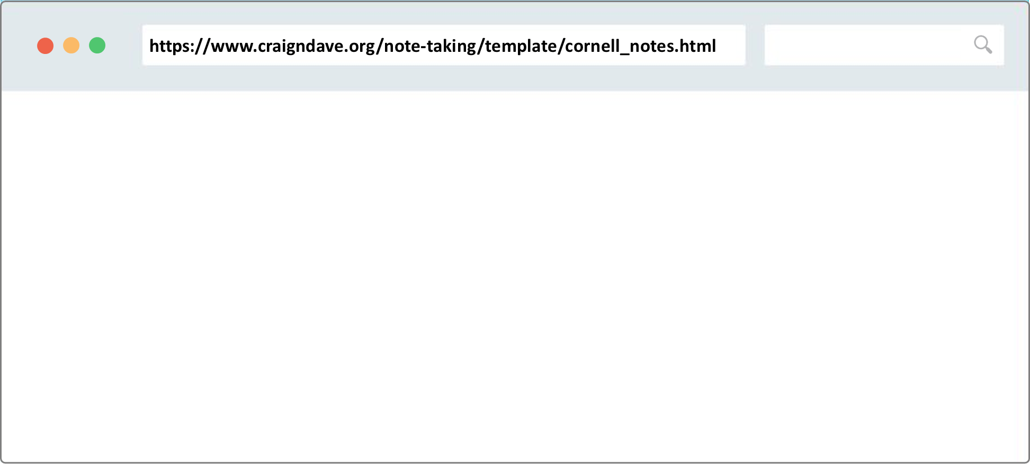
The parts of a URL
Protocol
method
Host
Domain name
Location
Resource (web page/file)
https://www.craigndave.org/note-taking/template/cornell_notes.html
Website domain name
Fully qualified domain name
Uniform resource locator (URL)

Slide 5
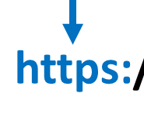

The parts of a URL

Slide 6
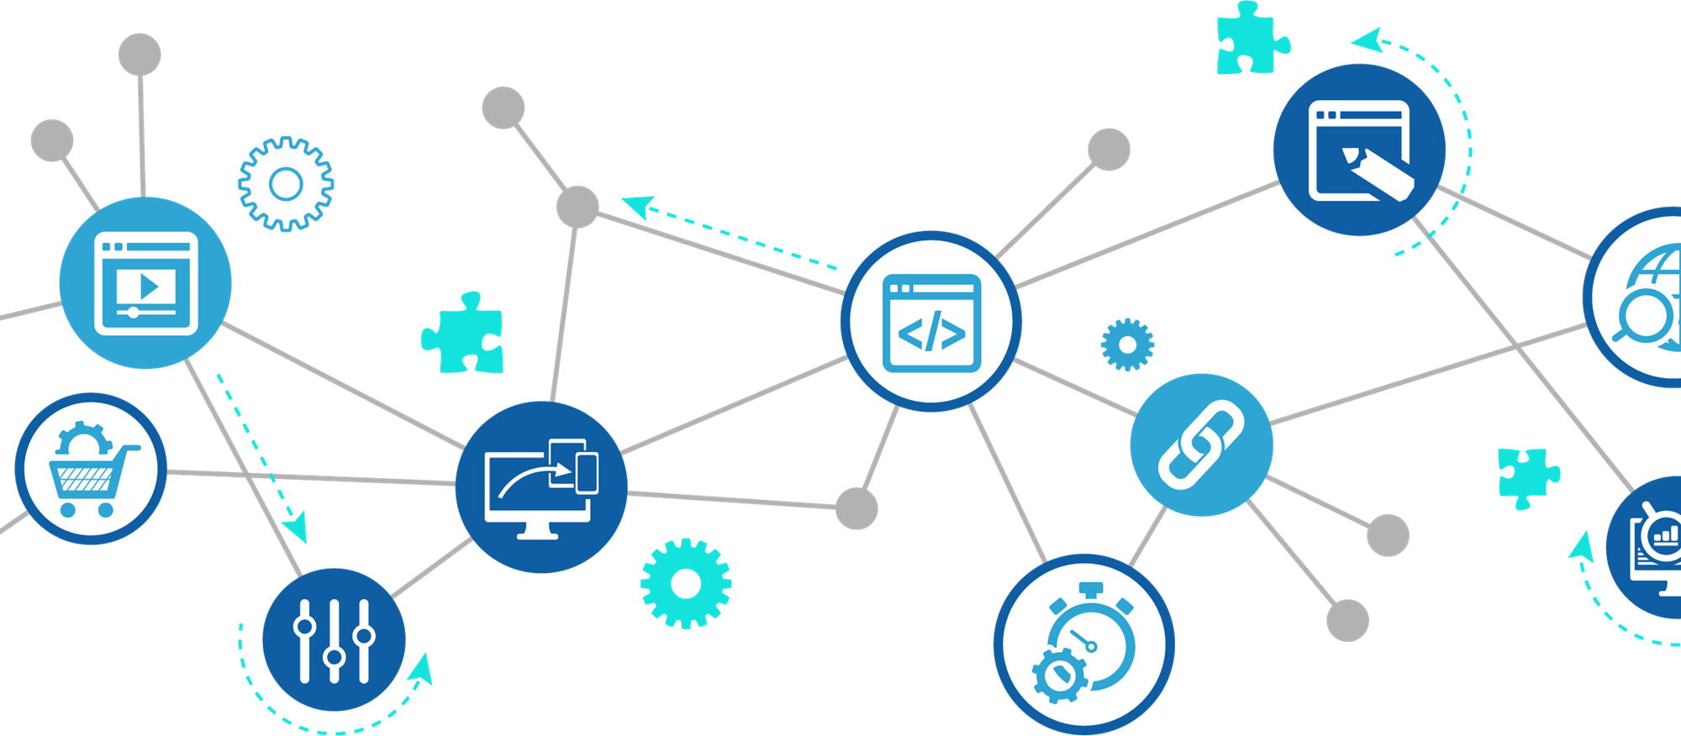

HTTP and HTTPS
https://www.bbc.co.uk
The Hypertext Transfer Protocol (HTTP) is a way for a clients and servers to send and receive requests and deliver HTML web pages – it is the fundamental protocol of the world wide web.
The Hypertext Transfer Protocol Secure (HTTPS) is effectively the same as HTTP, except it adds in encryption and authentication.
HTTPS should be used whenever a website deals with sensitive information such as passwords or bank account details.

Slide 7

HTTP and HTTPS
A protocol is a set of rules that allows two devices to communicate.
HTTP (Hypertext Transfer Protocol): A client-server method of requesting and delivering HTML web pages.
HTTPS (Hypertext Transfer Protocol Secure): Encryption and authentication for requesting and delivering HTML web pages. Used when sensitive information needs to be transferred – e.g., passwords, bank account details.

Slide 8


